Slide 1
Rapporteur session Track C
Omar Sued- Fundación Huésped
@omsued71
@fundhuesped
Share your thoughts on this presentation with #IAS2019

Slide 2

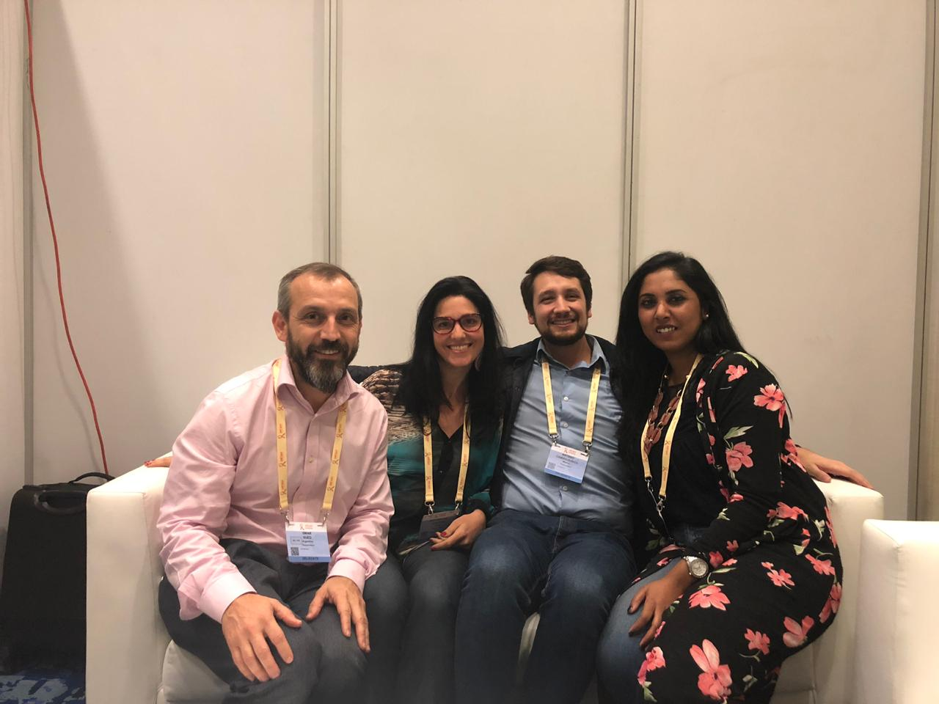
Team & Outline
Ana Garcia Ferreira-Brazil
Nicolette Naidoo-South Africa
Antonio Camiro-Mexico
Specific populations
  TG
  Youth
SRH
Selftesting
PrEP
New biomedical products
Ana Garcia Ferreira: acgferreira@gmail.com
Nicolette Naidoo: nnaidoo@wrhi.ac.za
Antonio Camiro: antoniocamiro@hotmail.com

Slide 3
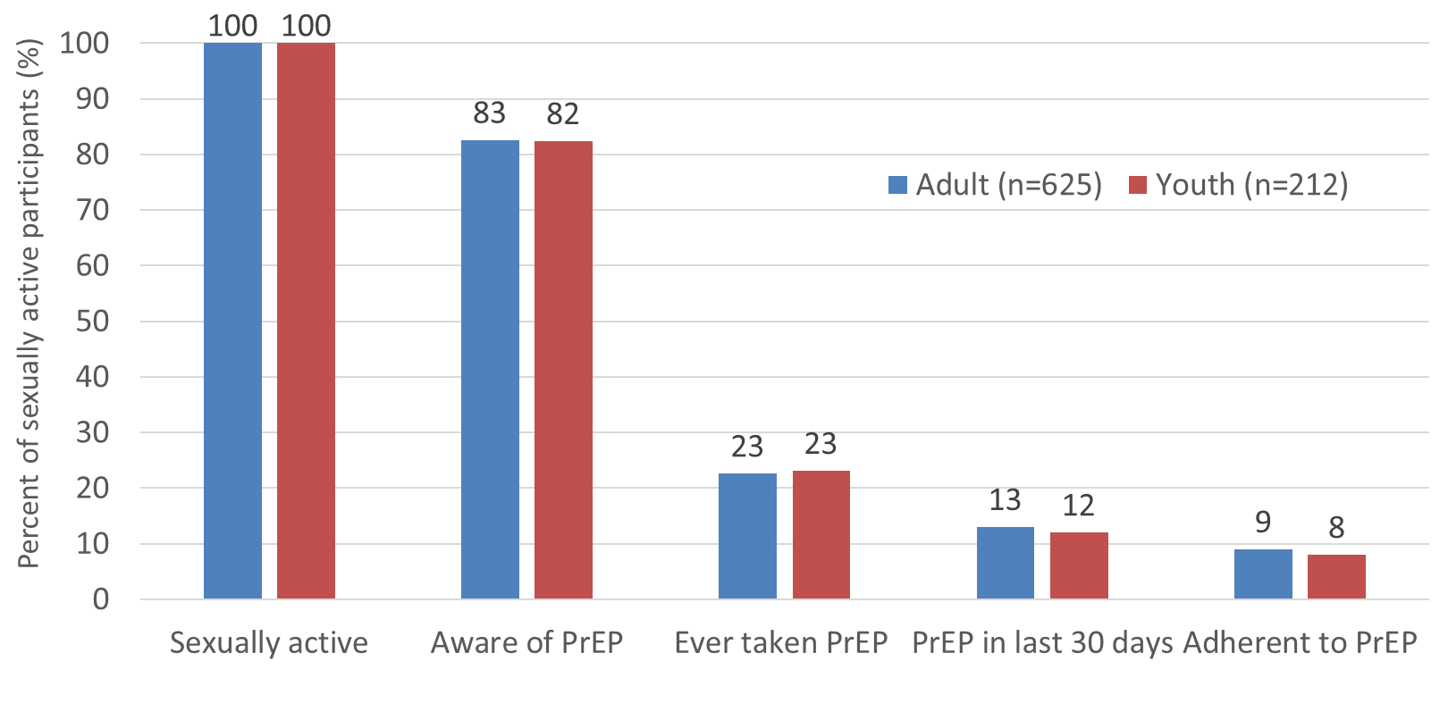
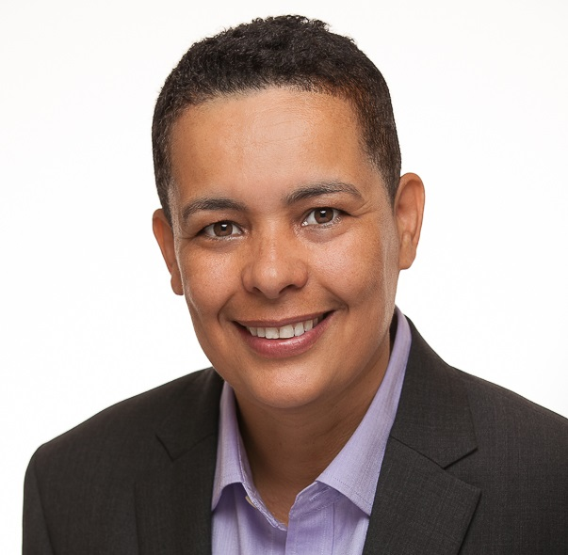

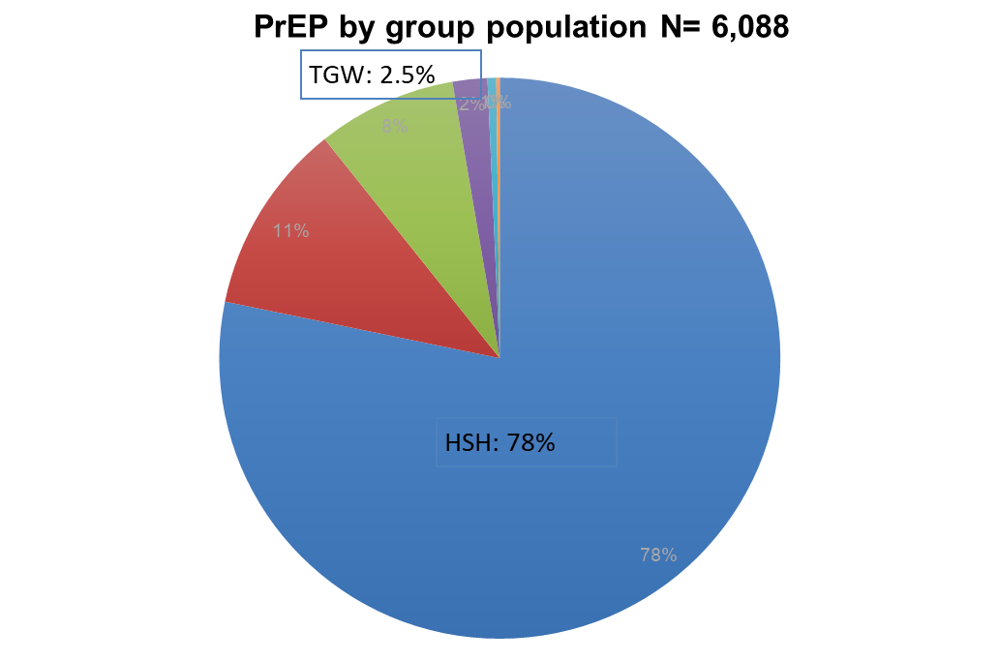

Transgender Women (TGW) = most affected population
Monday´s Plenary
PrEP continuum among TGW
Housing
MOBS01
TUAC01
Poverty
Drugs
STIGMA
Depression
Violence
TUAC0103: 50% syndemics
Drugs
IPV
Depression
Alcohol
Sexual Compulsion
  Not just about HIV or PrEP understand and address social and structural vulnerabilities
Notes:
Dr Radix closed AIDS 2018 as Track C rapporteur requesting for more information about trans in this conferences. This year, for first time IAS included a plenary dedicated to trans. We could see the low rates of engagement on the PrEP continuim.
But in addition there were other 2 sessions, and 88 abstract dedicated to transgender issues. Most highlighted the many challenges this population is suffering, agravated by the Stigma, that are affecting the Prevention and care continium, and evidenced by this important study in Brazil, where they could objetively measure by validated tests the presence of syndemic in half of the HIV negative TGW that could affect the uptake of PrEP.

Slide 4

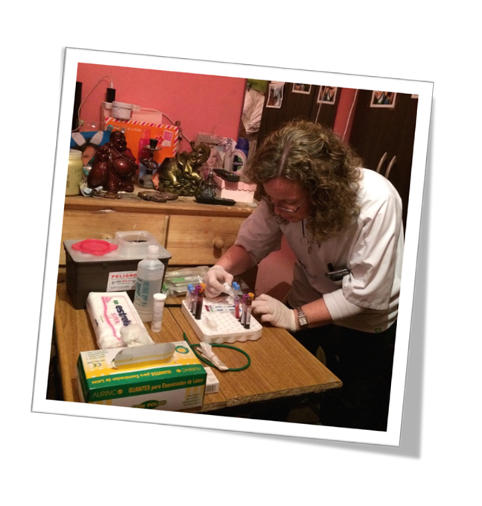
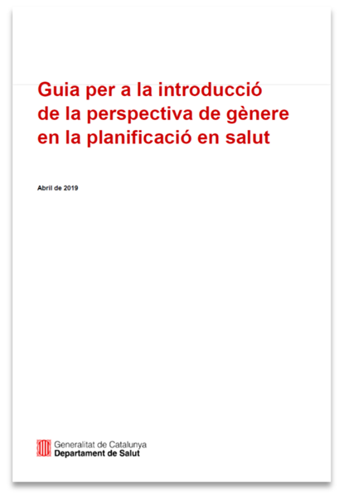
Solutions, ideas and opinions….
MOBS0104 Importance of GA therapies, but this is not enough
MOBS0105 Compentent service delivery
MOBS0102 Goverment involvement
Legal recognition is URGENT!!
TUAC0102 Domiciliary testing for integrated HIV- syphilis highly acceptable
How improve TG investigators presenting its own research?
If the English is the problem, where is the translation?
Notes:
But also in this conference we saw Good practices, such as
the importance of colocate gender affirming therapies, while advocating and working for structural interventions to ensure the syndemics
The Benefit of a the provision of competent care led by trans staff, in terms of reducing stigma and increasing acces
The possibility of making significant changes when goverments and public agencies are involved, in particular providing legal recognizing.
And the potential of domiciliary interventions such as integrated HIV and syphilis test in argentina, but also can incorporate home base treatment
In the rooms many people voiced the need to incorporate TG not only in the research but also in the presentation of the results

Slide 5
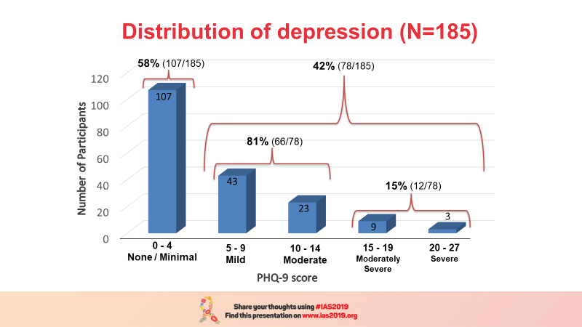
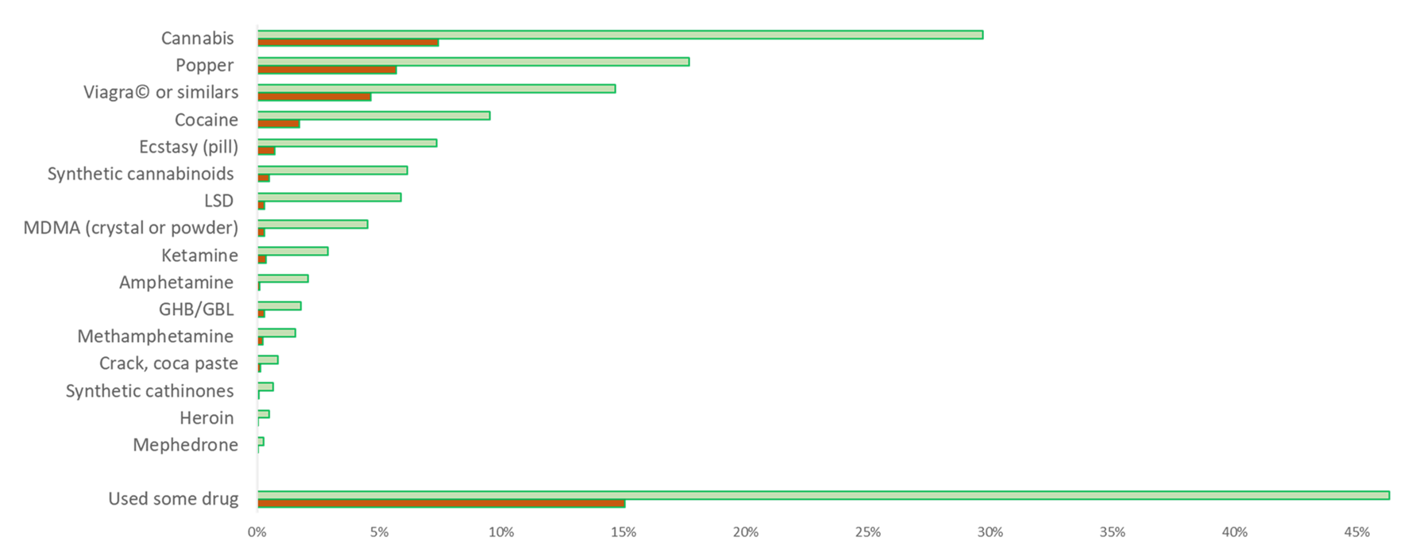
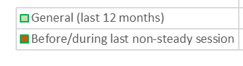
MSM depression and chemsex
MOAC0104: 42% of depression (PHQ-9 ≥5) among MSM in Perú. Most mild-moderate.
MOAC0101 & MOPEC363: online survey (n=64.655) 13.6% of MSM used chemsex in the last year, and 6.7% in the last month.
Age, education, income, and living in larger cities = higher Viral Supresion
Drug use during sex
Notes:
Jerome Gadea showed this high rate of depreseion among MSM in Peru, most with mild and moderated
A large online survey evidenced a high use of drugs during sexual relationships, in particular in south cone Cannabis, Cocaine and Ecstasy the most reported. Among HIV positives, big disparities regarding viral supression

Slide 6
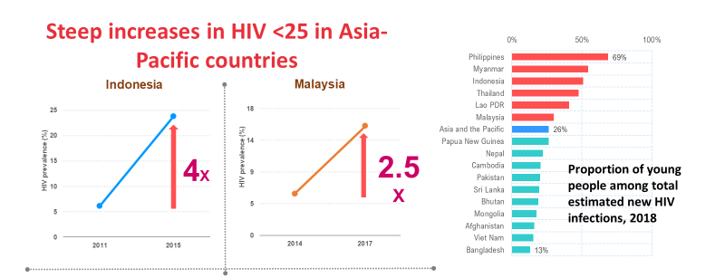
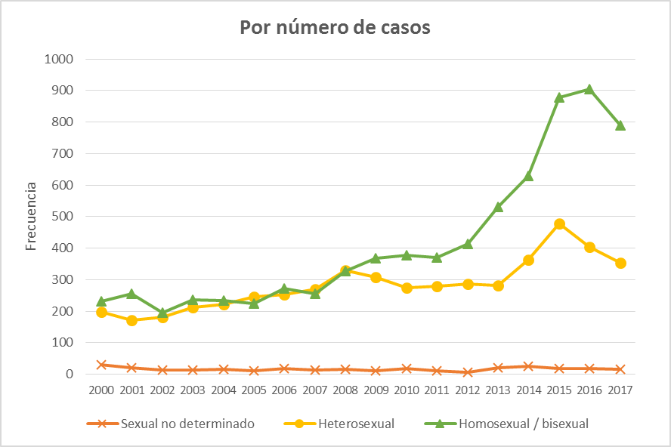



Adolescents and Youth
TUPL01: In LAC HIV epidemic among adolescents MSM is growing.
and POWER
  - High PrEP Uptake & high STI incidence
  TUPEC479 - PrEP initiation was significantly associated with contraception initiation on the same day
  PrEPX – younger age associated with STIs, BUT STI services can be a demand creation tool because of age differential
Notes:
Caceres presented the plenary
Adolescents girls showed higher HIV incidence in the ECHO trail in 3 countries in africa. An HPTN082 and POWE shoed high PrEP uptake
It is important to integrate PrEP in contraception and STI managmente in Young girls

Slide 7
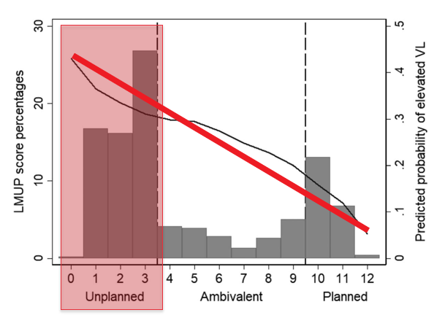
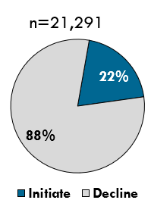

SRH and HIV Prevention
WESY0101 - More evidence needed on effect of PrEP on STIs BUT absence of evidence is not evidence of absence
WESY0104 - WLHIV with unintended pregnancy have worse ART outcomes on average
TUAC01 – women initiate PrEP when offered in MCH/FP
  Higher HIV incidence among AGYW, but not difference between methods, and high acceptability of preventive interventions
Notes:
Landon Myer shows that WLHIV with unintended pregnancy have worse ART outcomes on average - reducing unintended pregnancies as a goal of integrating contraceptive & family planning services into ART, particularly in those on DTG where NTD are a concern. Increasing food folate fortification & reducing unintended pregnancies will help shift the risk-benefit balance.

Slide 8
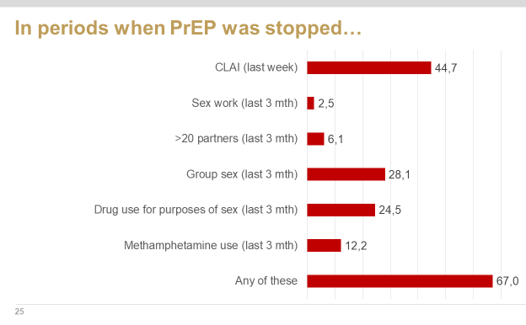

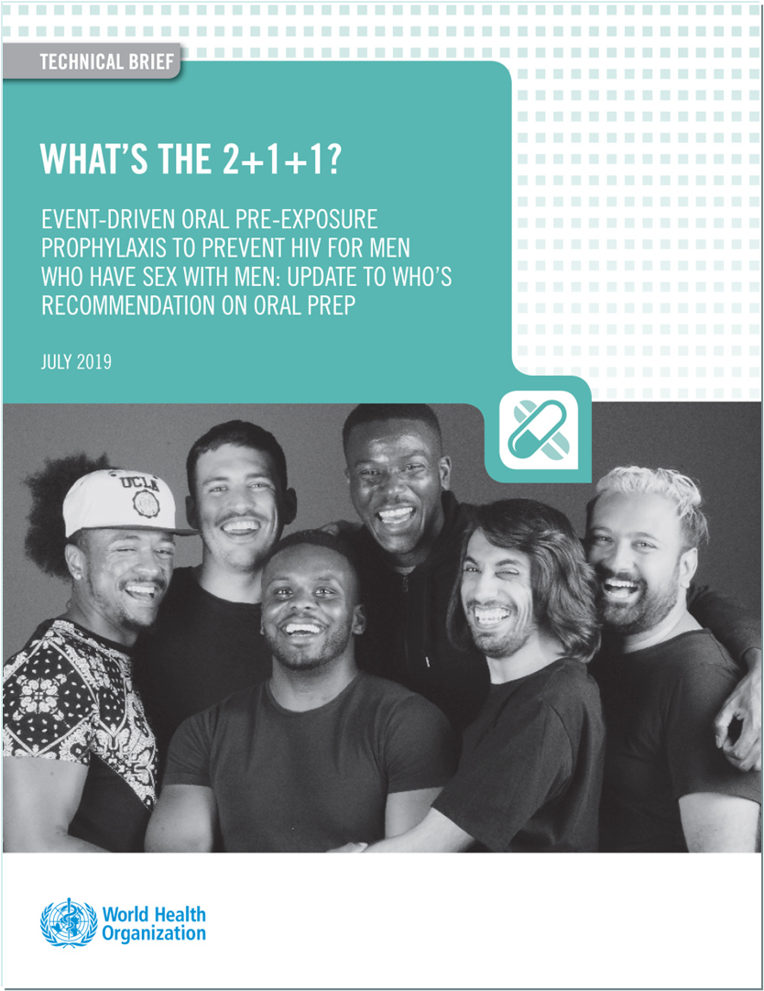
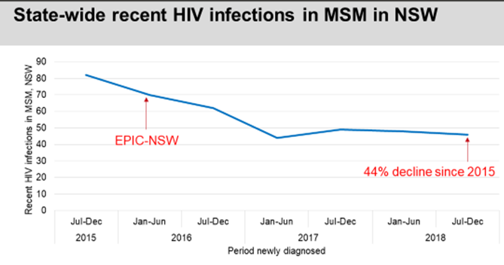

STOP START RESTART
  TUAC03 EPIC - Risk profiles change → data showing intentional discontinuation – implications for definition and measurement of PrEP continuation
TUAC0201 EPIC study incidence ↓ 44%
  Even higher in gay post codes zones
  13% stopped PrEP >3 months (35.9% restarted)
    8% >20 partners,
    Up to 30% reported substance use
    52% reported any CLAI in the last week
TUACO202 PREVENIR study
  Open cohort 3057 participants 2 modalities
  9 months follow-up. Only 2 infections.
Notes:
IN Australia, the nationwide PrEP program continued Rolling out, wiht almost 20000 individuals demonstrating a 44% decrease in recent infections. There were still some infections in non adherent men, and one case of M184V. Current coverage is 50% and modeling suggest should increase to 75% to eliminate HIV. The issue of stopping and re’stareted PrEP is crucial.
In the prevenir study, a open cohort providing Truvada daily or on demand, provide reasuring results of the efficacy of PrEP in Paris with only 2 infectiosn in non adherents. The incidence was 100 times lower than the baseline from ypergay. 50% choosed on demand. On demand PrEP patients have less partners, less condomless sex and a lower incidence of bacterial STIs . Ipergay study and this provided important evidence that allowed WHO recomned PrEP in a on demand basis.

Slide 9
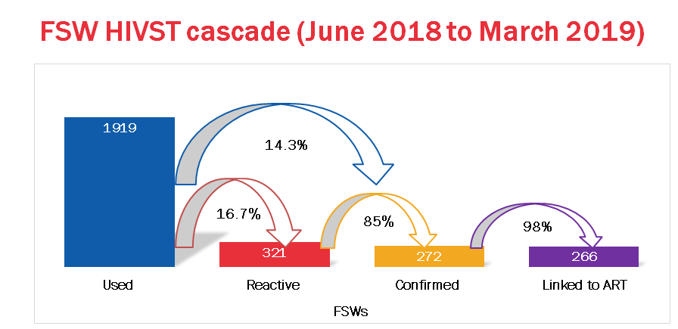
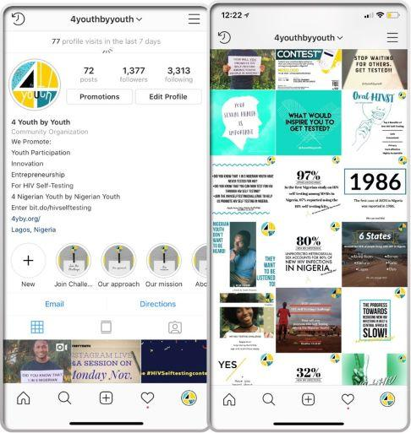
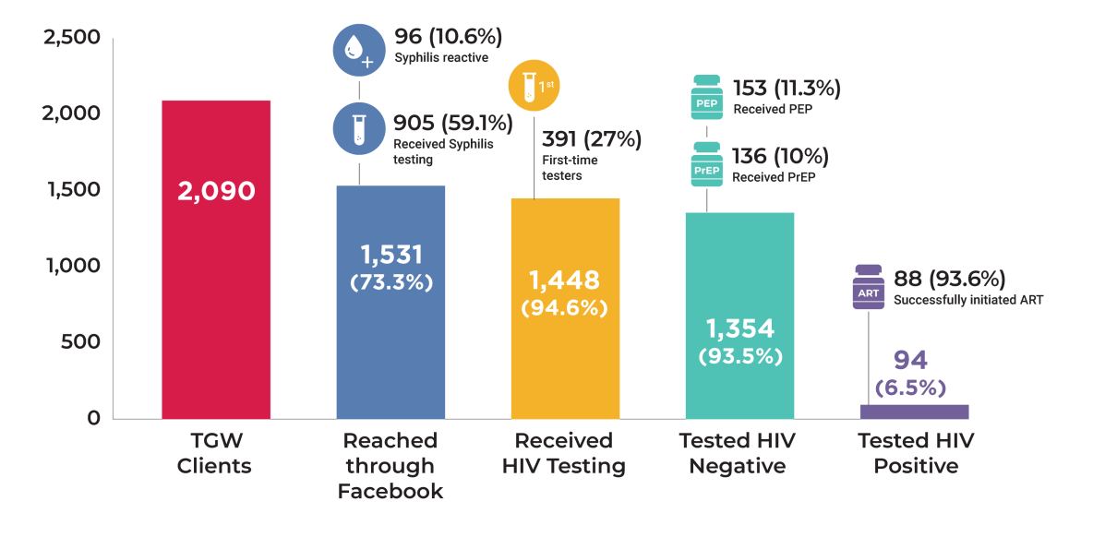
WEAC0203 SELFESTING
WACO0202 & 03: rapid distribution feasible, highly acceptable in MSM and FSW, improving 90/90/90
WEAC0201: risk of coercion and regret when delivered by peers.
WEAC0203 DIGITAL
WEPDC01 – 3.5 million reached #HIVSelfTest
WEPDC04 – 1531/2090 of TGW reached through FB
Notes:
Selfesting is a WHO recommended intervention, but the uptake is limited. Here, we saw many studies improving access to care among K P, however, a note of concern when the test were not requested, as in this study where peer were hired to distribute tests

Slide 10
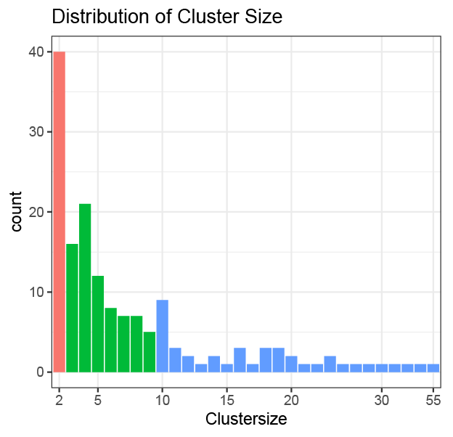
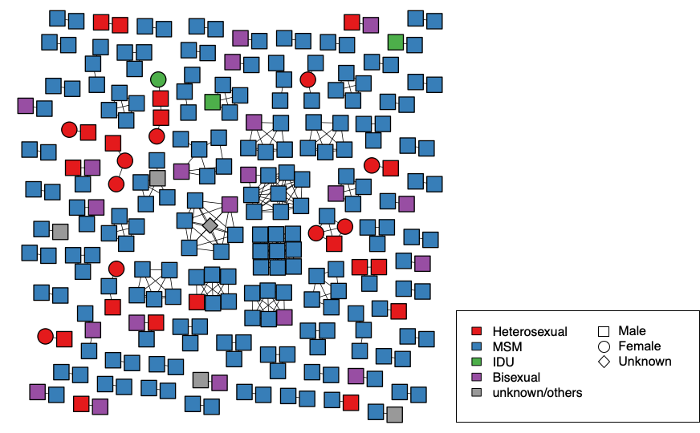
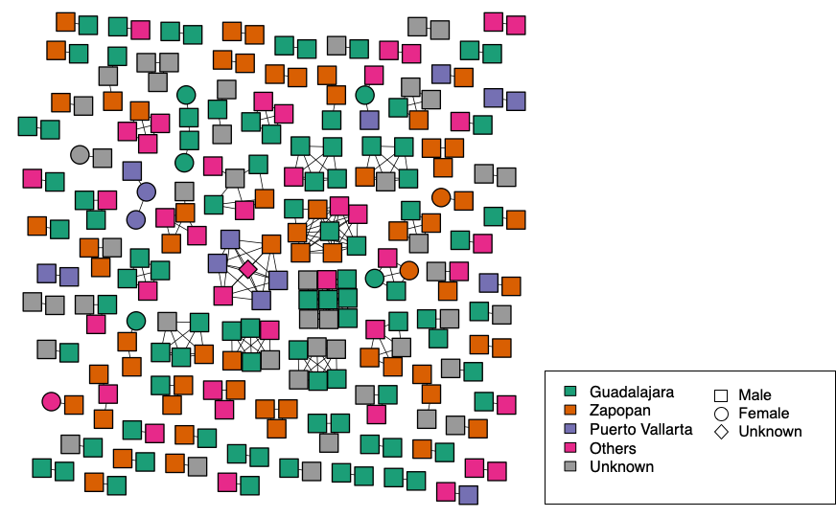
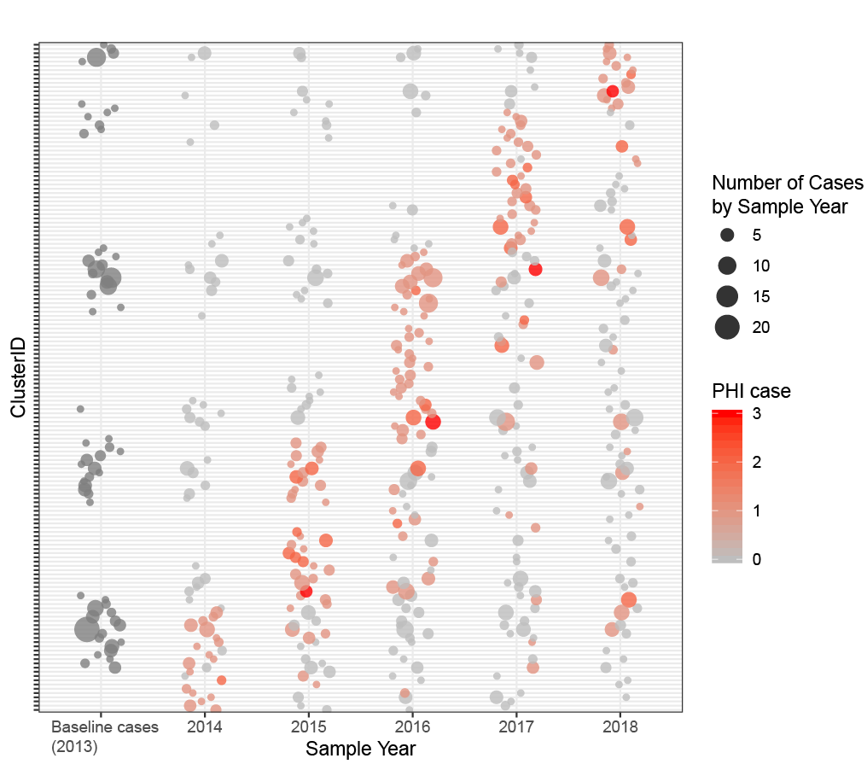
WEAC01 New tools for interrupting transmission
WEAC0102 Avila. HIV genetic newtoks (HIV trace)
WEAC0101 Dennis. Transmission linkages
WEAC0103 Gian Le
In Hanoi, 11% incidency in MSM using recency study
WEAC0104 Guajira. ImPrEP study 20 acute infection in 5375 PrEP users.
WEAC0105 Skaathun using Recency and HIV TRACE
Confirm the importance of detecting acute HIV infection (WPL01)
Epidemiology should include new technol.
Suggest to implement recenty test for epidemiological interventions
Acute HIV infection does not prevent the use of same day PrEP (0.3%) ImPrEP Study
Youth have larger clusters
Notes:
This session presented the use of sanger sequences with HIV/TRACE for molecular epidemiology, and recency studies to identify recent infectios.
And studies in Mexico showing HIV youth clusters are larger and located in urban areas.
In the US individuals with acute HIV infection, cluster are common, and tend to persist along the time. Remember the today’s plenary, that stressed the importance of diagnosis and early treatment of acute HIV infection.
However, the risk of acute HIV infection among people initiating PrEP is low in LAC, with a 0.3% in the ImPrEP study

Slide 11
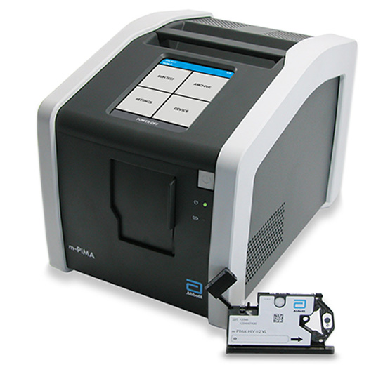
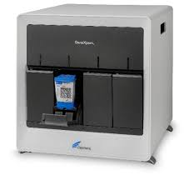
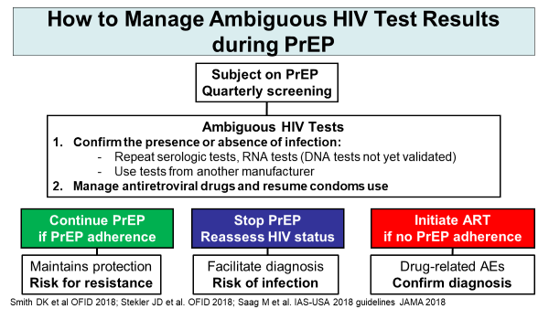
The labs challenges of PrEP: Testing and Resistance
TUSY0202: Serologic diagnosis and molecular POC tests
TUSY0203: Ambiguous test results in individuals during PrEP
TUSY0205: Low isk of resistance, conside in areas with high prevalence of K65R. Tails in long acting (CAB, RIL).
Call Dr Molina !!!!!
Notes:
The availability of molecular POC could be useful in this scenario, and when users shows ambiguous test results. Dr Molina gave a enriching talk about how to handle these cases. At the end of the day, as he said, you might need to call an expert due to the complexities of these very few cases, please do not call him at night.
Resistance would not be a problem for PrEP roll/out, with the potential exception of places with high prevalence of K65R.

Slide 12
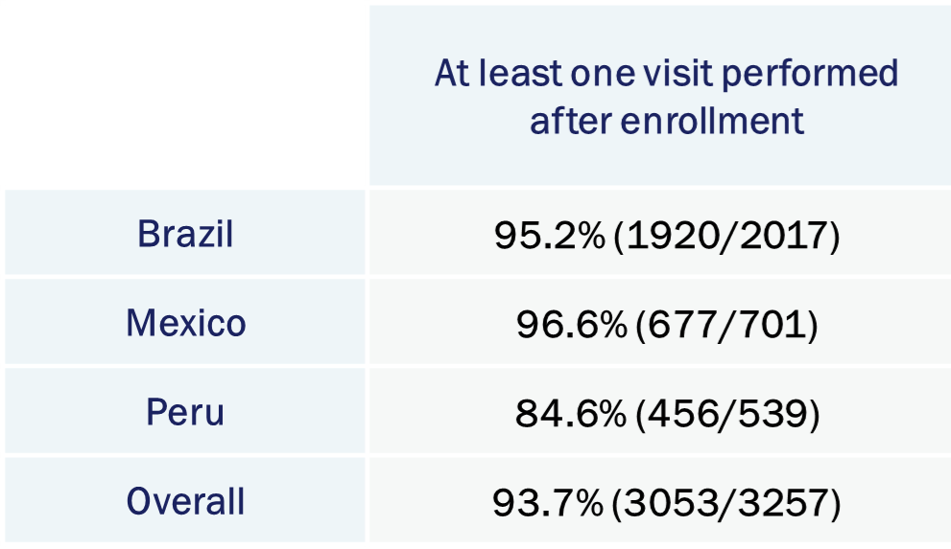
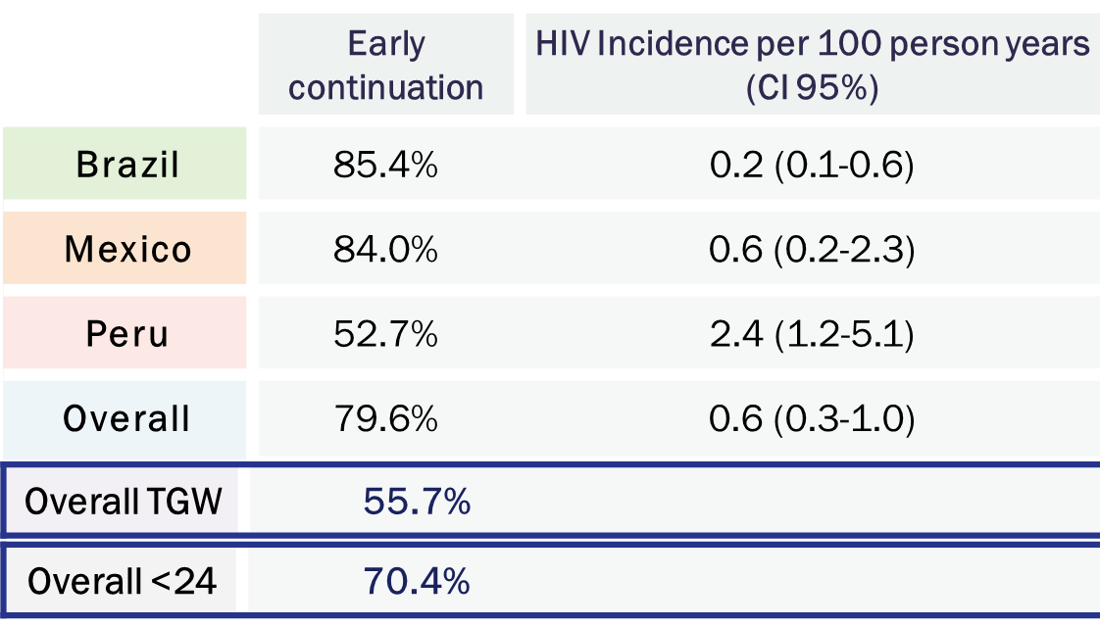
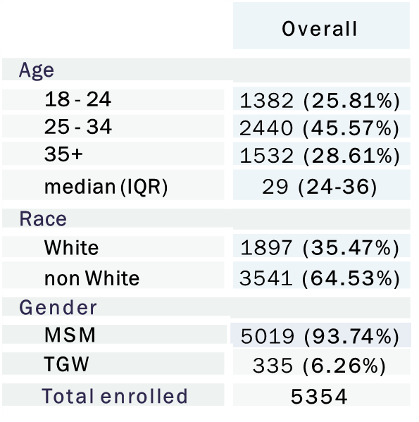

TUAC0404: Same day PrEP: ImPrEP Study
30 sites in BRA-PER-MEX
High prevalence of STI at screening.
Important differences between countries that could impact outcomes (gender, alcohol, drug use, sex work, reasons for attendance).
Intervention feasible and safe.
Lower retention in TGW and adolescents
Notes:
In this conference we could see the first results of the largest SAME DAY PrEP trial, being carried here in LAC, led by brasil and involving Mexico and Peru. Currently there are 5000 thousand users, with a very high linkage. Significant differences among countries were identified, affecting retention, in particular in Peru, and among TGW or adolescents.

Slide 13
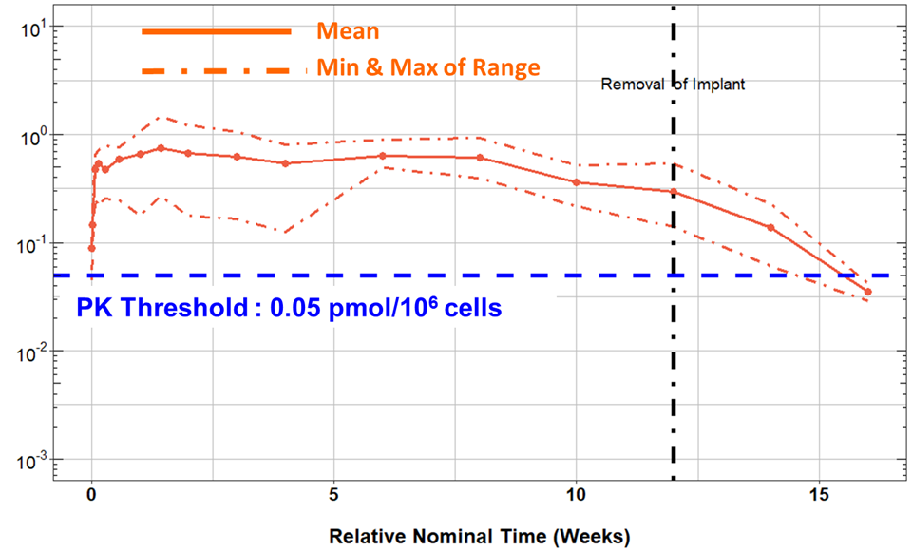

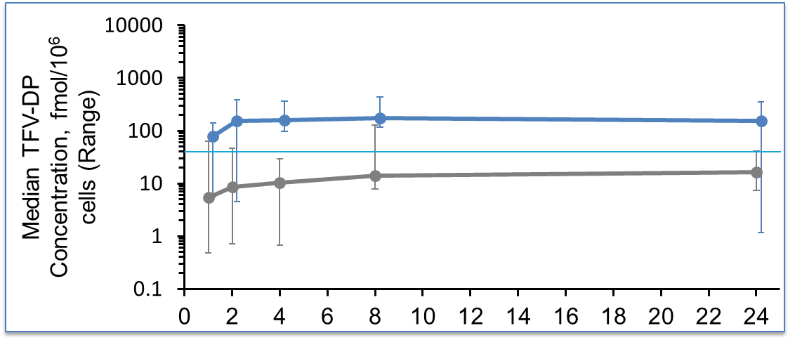
News in Biomedical Prevention
TUAC0401: Islatravir (MK-8591) implant (similar to Nexplanon®) tested in 16 healthy individuals with 2 doses (54 and 62mg). The higher doce achieved protective concentrations for at least 1 year. Well tolerated,
TUAC0403: DISCOVER Trial post hoc analysis.
No difference between arms of HIV risk, STIs or adherence.
PK analysis showed better PBMC levels, rapid onset and longer duration of protective levels.
Notes:
The inibitor of the translation MK8591, now baptized as ISLATRAVIR, was evaluated as an implant, similar to nexplanon, a long acting contraceptive. The study enroled 16 healthy volunteers receiving 2 different dosis. Both dosis achieved high drug levels for several months, the higher could support levels for more tan 1 year. Nice for PrEP, we should evaluate it alone? Or combined?
A post hoc análisis of DISCOVER was presented, measuring levels in PBMC, showed TAF achieves higher levels and more quicly tan TDF. But what is the significance? Nobody knows until more research is done

Slide 14
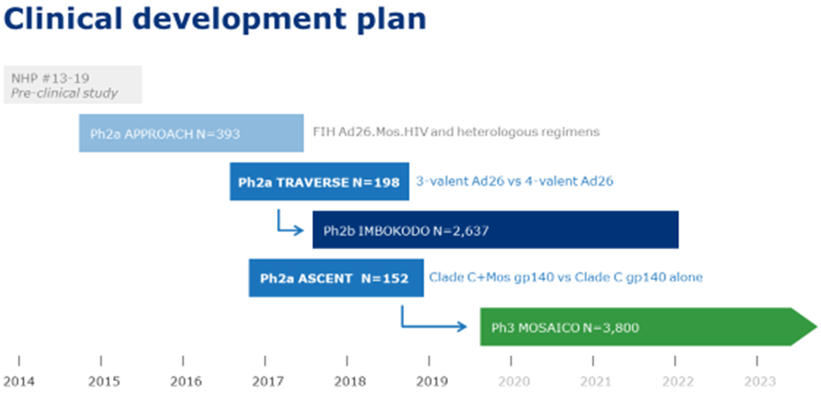
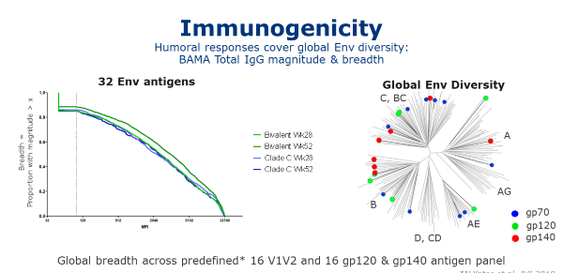
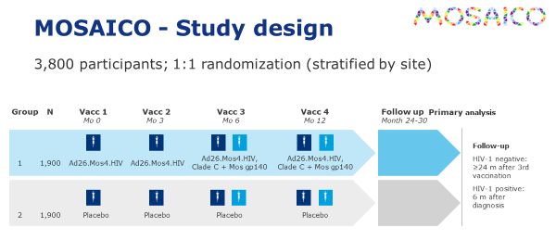
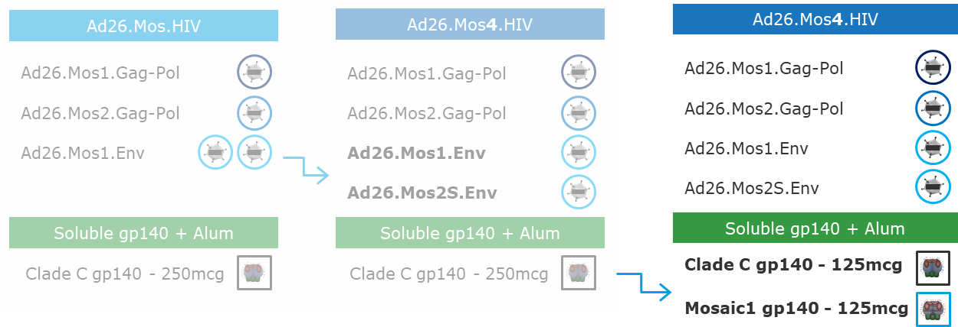
A vaccine ASAP please!
Notes:
Traverse study was designed to evaluate safety and toleratbility and immunogenicity of 2 different vaccine regimens.
ASCENT: Phase 2a, randomized, double-blind, placebo controlled study evaluating safety and immunogenicity of two HIV-1 prophylactic vaccine regimens comprising Ad26.Mos4.HIV and either clade C gp140 or bivalent gp140
Background: Mosaic HIV-1 antigens induce broad immune responses and aim to provide protection against diverse HIV-1 strains. Heterologous vaccination regimens including Ad26 and gp140 have conferred significant protection in NHP, and were safe and immunogenic in humans.
To optimize breadth, and refine the vaccine composition, ASCENT assessed adding Mosaic1 gp140 to clade C gp140 in the regimen.
Methods: This study was conducted in adults in Kenya, Rwanda and the USA. Participants were randomized to Ad26.Mos4.HIV at weeks 0 and 12, and Ad26.Mos4.HIV and alum adjuvanted gp140 Env protein (250µg clade C gp140 or bivalent clade C-Mosaic1 gp140, each 125µg) at weeks 24 and 48 or placebo.
Serious adverse events (AEs) were assessed throughout the study, unsolicited AEs until 28 days post-each vaccination, and solicited AEs until 7 days post-each vaccination.
Results: 152 healthy adults (18-50 years; 59% females) were vaccinated with Ad26.Mos4.HIV and clade C gp140 (n=26), Ad26.Mos4.HIV and bivalent gp140 (n=100) or placebo (n=26). Active regimens were well tolerated (most AEs were mild/moderate; no serious AEs).
HIV Env-specific binding antibody levels and subclass distribution showed both regimens induced binding and functional antibodies to all antigens tested (Figure). Clade C responses were not attenuated by replacing half the clade C dose with Mosaic1 gp140, while clade B responses improved (p< 0.05).
At week 28, similar PTE Env ELISpot responses were observed, with medians of 444 and 452 SFU/10⁶ PBMC in bivalent or clade C groups, respectively. CD4+ (but not CD8+) T-cell ICS responses increased to Mos1 gp120 peptides in the bivalent relative to clade C group (0.147% vs 0.123% IL-2 and/or IFNγ+ CD4 T-cells, 81% vs 50% response, respectively).
Conclusions: Both regimens were well tolerated and immunogenic. ASCENT supports using bivalent clade C-Mosaic1 gp140 with Ad26.Mos4.HIV for expanded clade coverage in the phase 3 efficacy study trial starting in 2019.
In different Prodcued antibodies to diferente
Safety: both vaccines are well tolerated
Global breadth: bivalent regimen is globally relevant and induces broader immune responses
Cellular response: increase in Mosaic Env-specific CD4 T cells
Clade C responses: not affected by improved clade B and Mosaic specific immune responses
Ad26.Mos4.HIV and bivalent gp140 regimen selected for phase 3 efficacy study: MOSAICO

Slide 15
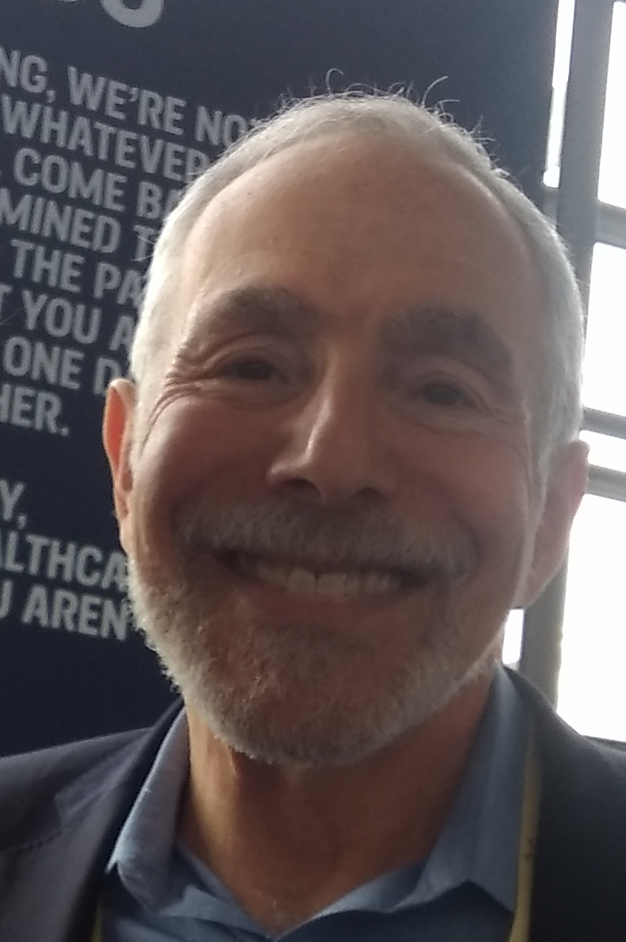
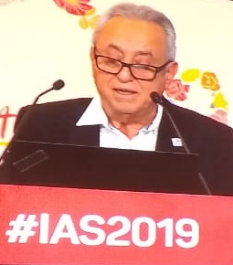
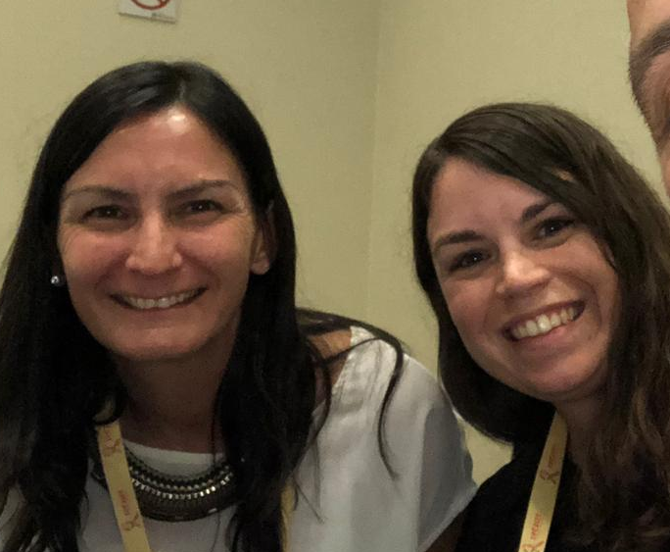

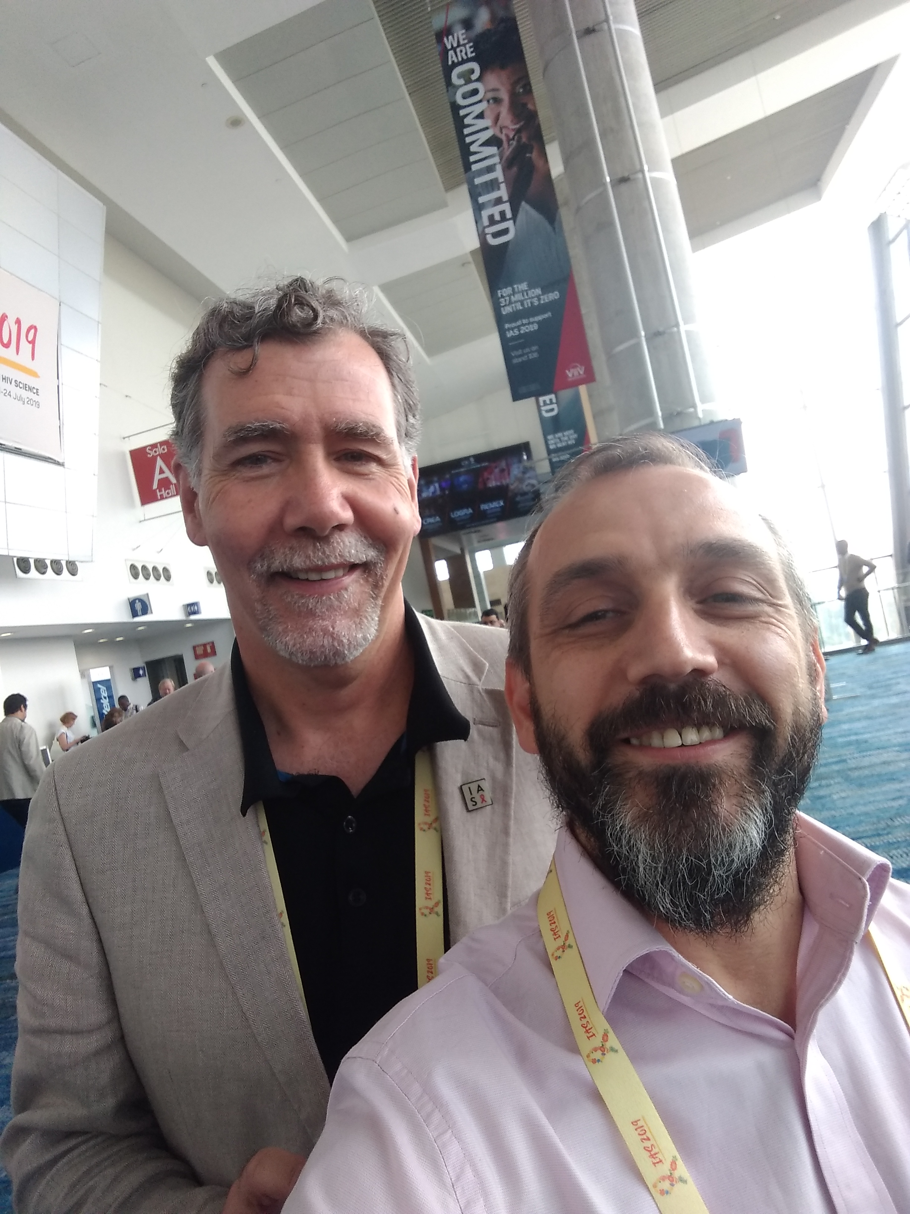
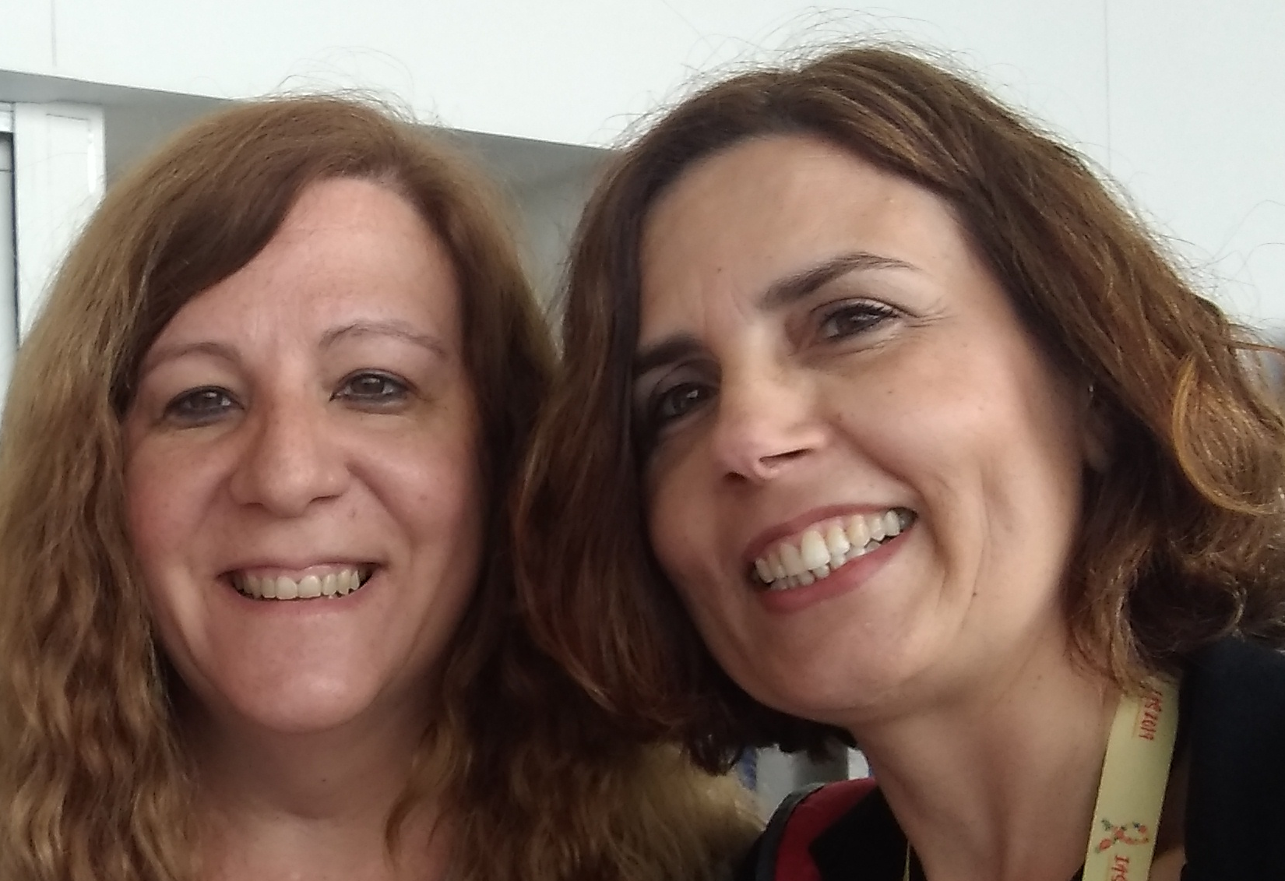


Other information you might look for…
TUAC0205LB - financial incentives conditional in education among girls reduce HIV incidence
TUAC0203 - Dapivirine was well accepted in the HOPE study, whith low HIV incidence
MOAX0101LB - HPTN 078. Case Management needed but not enough for very marginalized people
UPDC0103 - Conception services increase 90/90/90
TUPEC392 - Polysubstance↑ STIs but = PrEP
WEPEC525 - Peer navigators ↑ FSW testing
TUPEA110 - Raltegravir plus 3TC for PrEP
LBPEA08 - SINGLE 2 TAF/FTC/EVG/c on-demand PEP

Slide 16
Take home messages
Expand Selftest-PrEP-Same-Day ARVs and TASP for making impact at individual and public health level
Enhance participation and representation of TG
Increase focus in Youth MSM
Overcome Stigma and Syndemics
Use new technologies to improve programming
Stay tuned for implants and long term PrEP options

Slide 17

We need to make prevention SEXY
Ntando Yola, TUSY0204

Slide 18

